Slide 1
Tech Tips - Encrypting a Syntax File in IBM SPSS Statistics

Slide 2
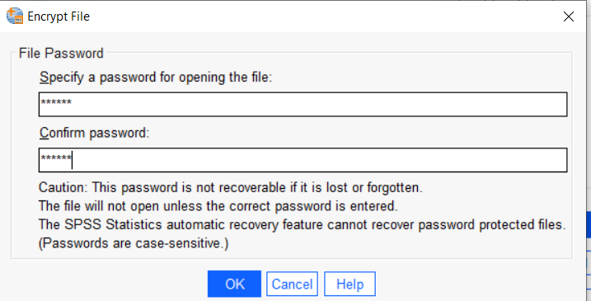
Tech Tips – Encrypt a Syntax File
Did you know you can encrypt a syntax file?
Encrypting a syntax file ensures that only those who have access to a password can change the file, ensuring the security of analyses.

Slide 3
Tech Tips – Encrypt a Syntax File
When saving a syntax file you can encrypt it.
Go to File > Save as
Provide a File name and ‘Save as type’ Encrypted Syntax. Click Save.
Provide a password and click OK. When you open the file later you will need to provide a password.
Please note that the password is not recoverable if lost or forgotten.

Slide 4
Demo

Slide 5
SPSS Tech Tips
For more Tech Tips, go to the Tech Tips section within the Learning Hub.
Contact us
SPSSAdmin@version1.com
+ 44 (0) 203 859 4790
+ 353 (0) 1 865 7800
www.spssanalyticspartner.com

