Slide 1
Tech Tips – The ANY Function
Presented By:
Version 1 SPSS Team
February 2023
Date:
Company Classification:
Externally available

Slide 2
Tech Tips – The ANY Function
The any function is a very useful logical function:
ANY(test, value1, value2, …)
Returns a value of 1 if the test is true and 0 otherwise.
E.g. ANY(var1, 1, 3, 5)
Will return a value of 1 if var1 has a value of 1, 3 or 5. Otherwise it will return a value of 0.
Use ANY instead of using a series of or statements
ANY(Var1, 1, 3, 5) = (var1 = 1 or var1 = 3 or var1=5)

Slide 3
Tech Tips – The ANY Function
The ANY function can also be used to scan a list of variables of expressions for a value.
For example, ANY (1, var1, var2, var3) returns a value of 1 if any of the specified variables have a value of 1, otherwise it will return a value of 0.
We will use a sample data file called cable_survey.sav.
The file is located in the installation directory for SPSS, in a folder called ‘Samples’.
We will use the ANY function in the select cases procedure to create a new dataset with categories of 1, 3, and 4 of the variable hometype.

Slide 4
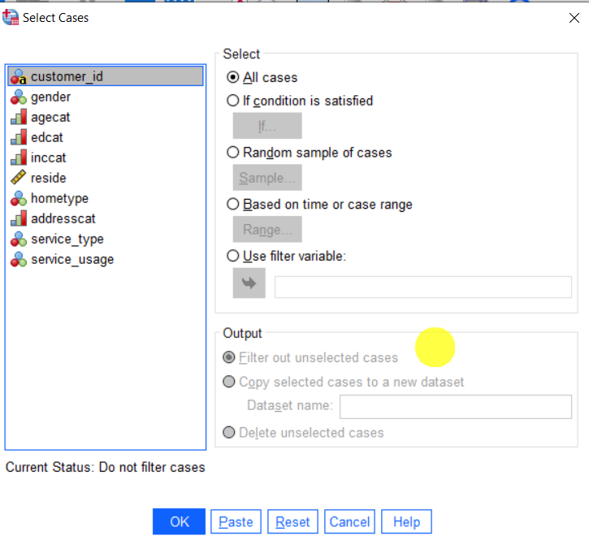
Tech Tips – The ANY Function
Go to the Data menu and chose Select Cases
Select the If condition is satisfied button

Slide 5
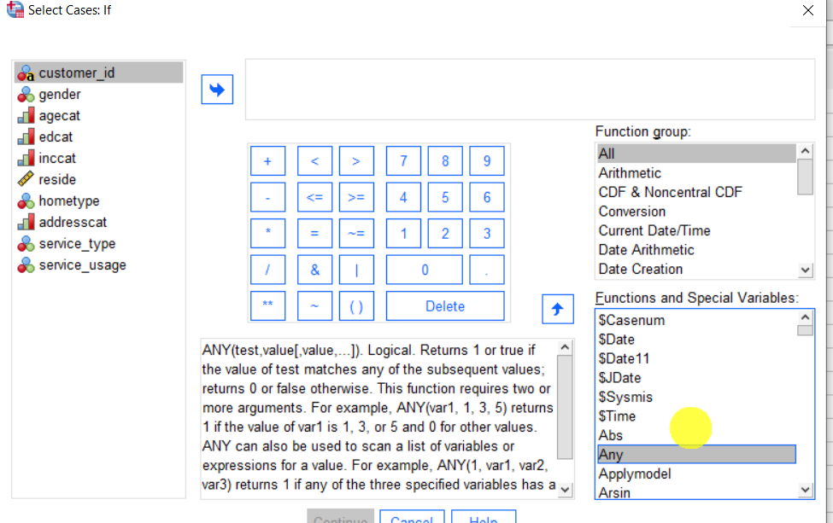
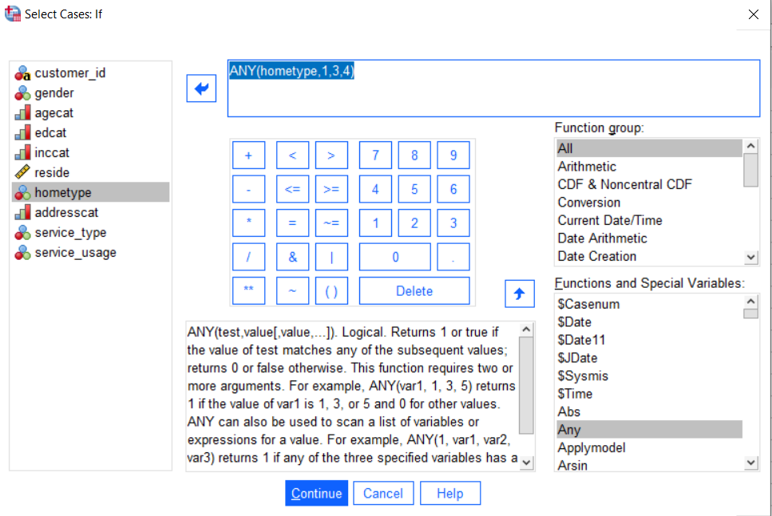
Tech Tips – The ANY Function
Select All functions
Select ANY and move this into the main box
Create the expression ANY(hometype,1,3,4)
Click Continue and select to move cases to another dataset.

Slide 6
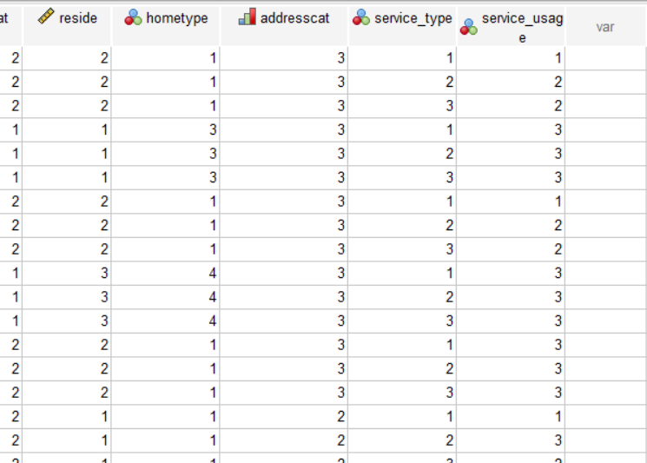
Tech Tips – The ANY Function
Now you can check the results in your new data file.

Slide 7
SPSS Tech Tips
For more Tech Tips, go to the Tech Tips section within the Learning Hub.
Contact us
SPSSAdmin@version1.com
+ 44 (0) 203 859 4790
+ 353 (0) 1 865 7800
www.spssanalyticspartner.com

Slide 8
Thank you.

