Slide 1
Tech Tips – Encrypting a Data File in IBM SPSS Statistics
Presented By:
Version 1 SPSS Team
February 2023
Date:
Company Classification:
Externally available

Slide 2
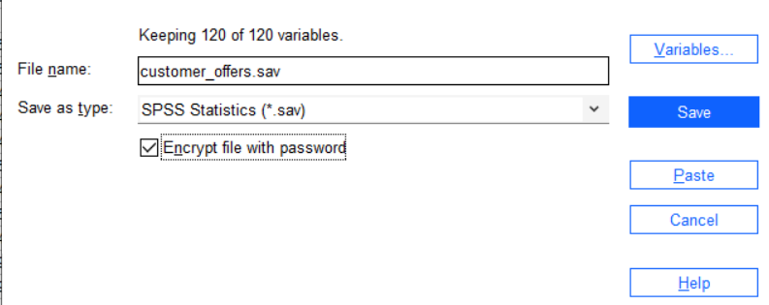
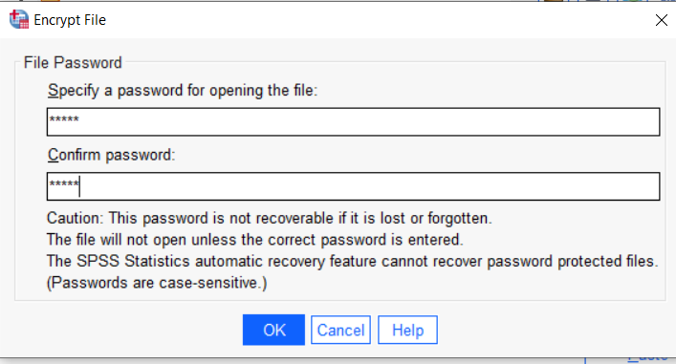
Tech Tips – Encrypt a Data File
Did you know you can encrypt a data file in IBM SPSS Statistics?
Encrypting a data file ensures that only those who have access to a password can access or change the file, ensuring the security of your data.

Slide 3
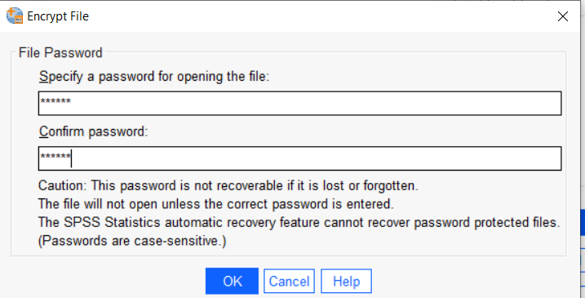
Tech Tips – Encrypt a Data File
When saving a data file you can encrypt it.
Go to File > Save as.
Provide a File name and tick Encrypt file with password. Click Save.
Provide a password and click OK. When you open the file later you will need to provide a password.
Please note that the password is not recoverable if lost or forgotten.

Slide 4
SPSS Tech Tips
For more Tech Tips, go to the Tech Tips section within the Learning Hub.
Contact us
SPSSAdmin@version1.com
+ 44 (0) 203 859 4790
+ 353 (0) 1 865 7800
www.spssanalyticspartner.com

Slide 5
Thank you.

