Slide 1
Tech Tips – Count Occurrences within Cases
Presented By:
Version 1 SPSS Team
February 2023
Date:
Company Classification:
Externally available

Slide 2
Tech Tips – Count Occurrences within Cases
Did you know that you can count occurrences within cases?
You might have a satisfaction survey that contains a lot of questions with the same scale.
You can use this procedure to calculate the total number of ‘Very Satisfied’ responses respondent gave across a number of questions.
Or, you might have a survey that contains a list of magazines where each magazine is a variable in your data and each respondent indicates Yes or No for each magazine.
You can use this procedure to calculate the total number of magazines each person reads.

Slide 3
Tech Tips – Count Occurrences within Cases
We will use the file satisf.sav – this file is located in the installation folder of SPSS in a file called Samples/
The last six questions in this data file are price, numitems, org, service, quality, and overall. These questions have the same response scale. The scale is shown below:
1 = Strongly Negative
2 = Somewhat Negative
3 = Neutral
4 = Somewhat Positive
5 = Strongly Positive

Slide 4
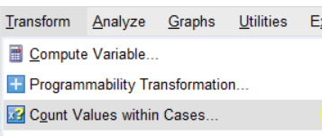
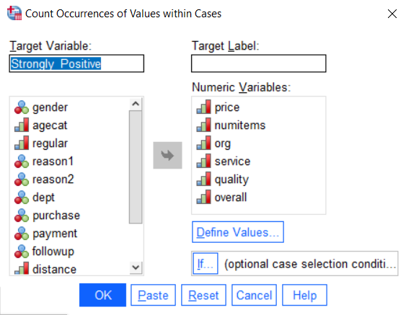
Tech Tips – Count Occurrences within Cases
Let’s count the number of ‘Strongly Positive’ responses across the variables.
To do this, go to the Transform menu and select Count values within cases.

Slide 5
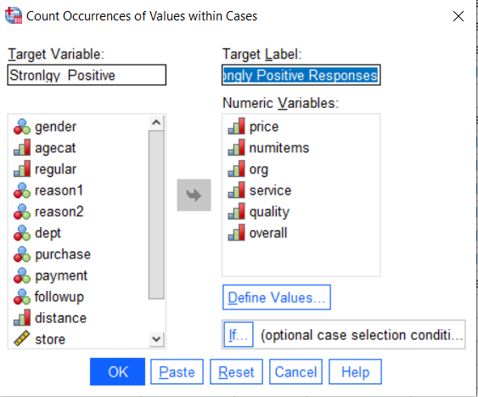
Tech Tips – Count Occurrences within Cases
In Target Variable box type ‘Strongly_Positive’.
In the Target Label box type ‘Count of Strongly Positive Responses+’.
Select the six questions and move then to the Numeric Variables box.
Click on Define Values.

Slide 6
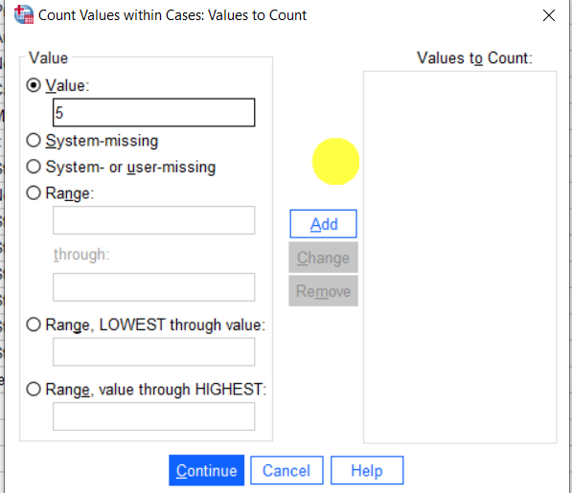
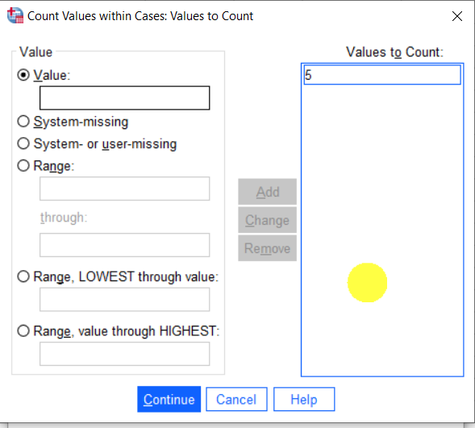
Tech Tips – Count Occurrences within Cases
As we want to count occurrences of ‘Strongly Positive’ select the Value button and type ‘5’.
Click on Add to Values to Count box.
Other options include specifying a range of values or specifying missing values as the value to count.
Select Continue and OK in the main dialog box.

Slide 7
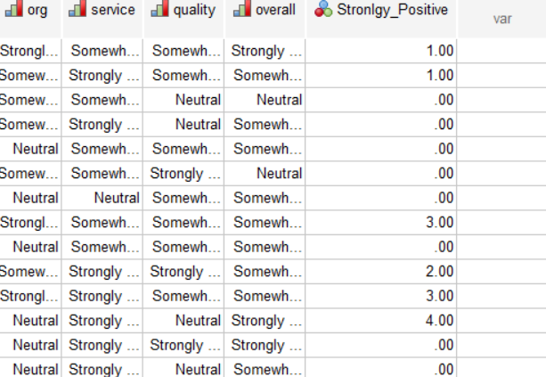
Tech Tips – Count Occurrences within Cases
Now you have a new variable in your data which counts ‘Strongly Positive’.

Slide 8
Tech Tips – Count Occurrences within Cases
The If cases dialog box allows you to count occurrences of values for a subset of cases using conditional expressions
If the result of a conditional expression is true, the case is included in the selected subset
If the results of a conditional expression false or missing, the case is not included in the selected subset

Slide 9
SPSS Tech Tips
For more Tech Tips, go to the Tech Tips section within the Learning Hub.
Contact us
SPSSAdmin@version1.com
+ 44 (0) 203 859 4790
+ 353 (0) 1 865 7800
www.spssanalyticspartner.com

Slide 10
Thank you.

